Slide 1
CITY GUIDE
“THE MASTERMINDS” TEAM MEMBERS:
Onica Rayineedi- 80
Venta Krishna– 72
Sreelekha KommaReddy – 45
Mamatha chekuti- 11

Slide 2
OBJECTIVES AND FEATURES:
This Application enables the user to search for the locations where the user wants to visit after which application will be navigated to a page where Tourist Attractions available in the location entered by the user will get displayed.
After Tourist Attractions got displayed, the user can select a place from the list of attractions after which entire details such as current location, history, significance, images, and reviews etc. of the place can be viewed.
This is associated with various applications which allows to view and book different amenities which are necessary to accomplish the trip.
The user can view and record the reviews about the visited place.
TECHNOLOGIES USED:
Code Development Tool Kit : JDK 7 , ANDROID SDK
Programming Language: JAVA
Integrated Development Environment: ANDROID STUDIO
Designing UI screens: XML
Versioning: GITHUB TOOL
Web Services: FOURSQUARE API,FACEBOOK API,GOOGLE MAPS API,MLAB

Slide 3
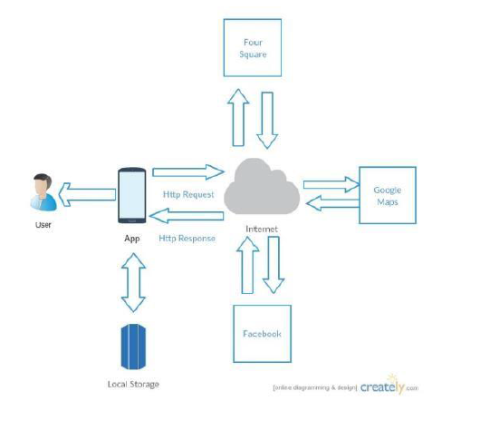
ARCHITECTURE

Slide 4
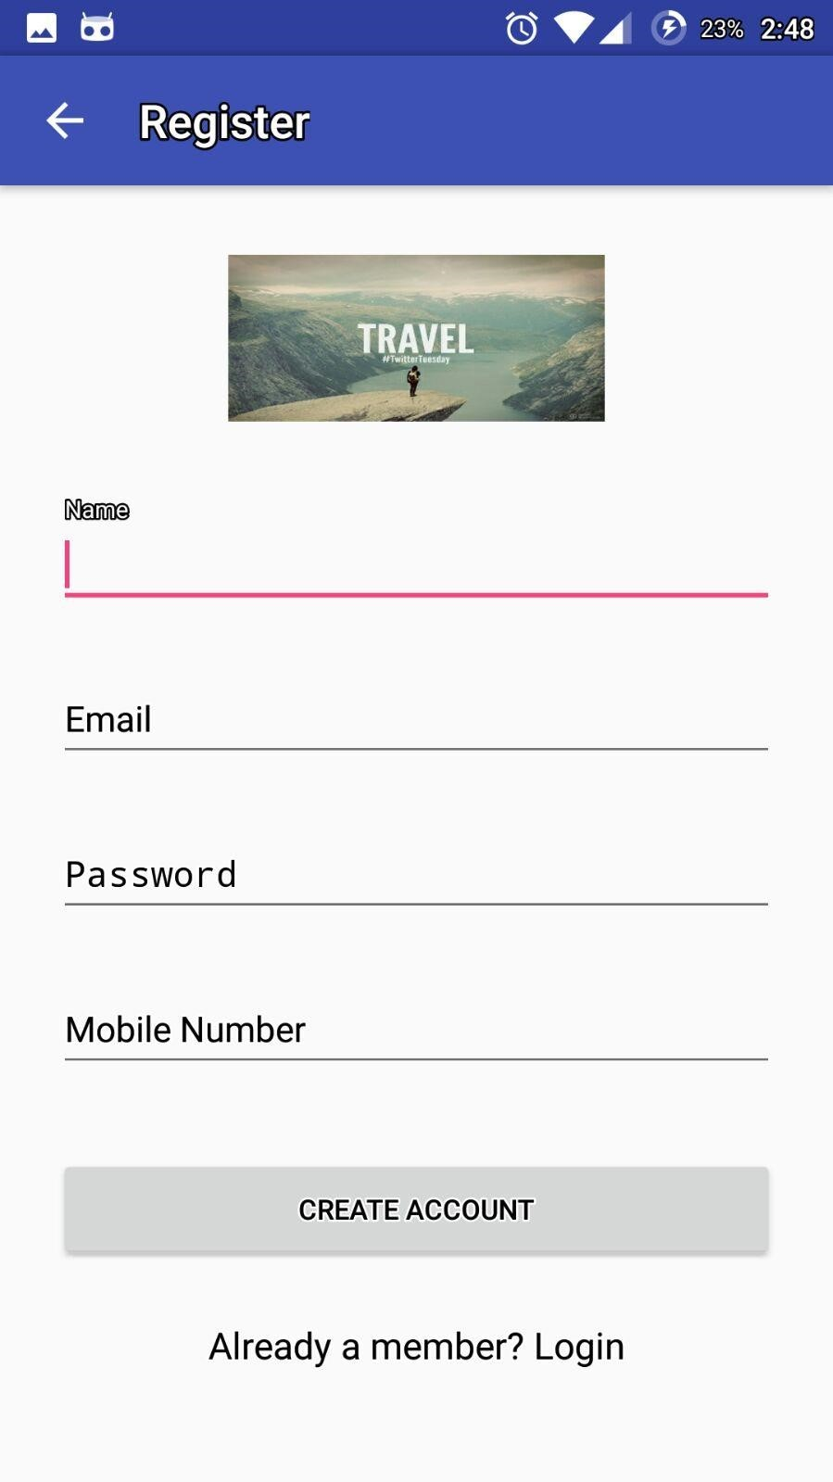
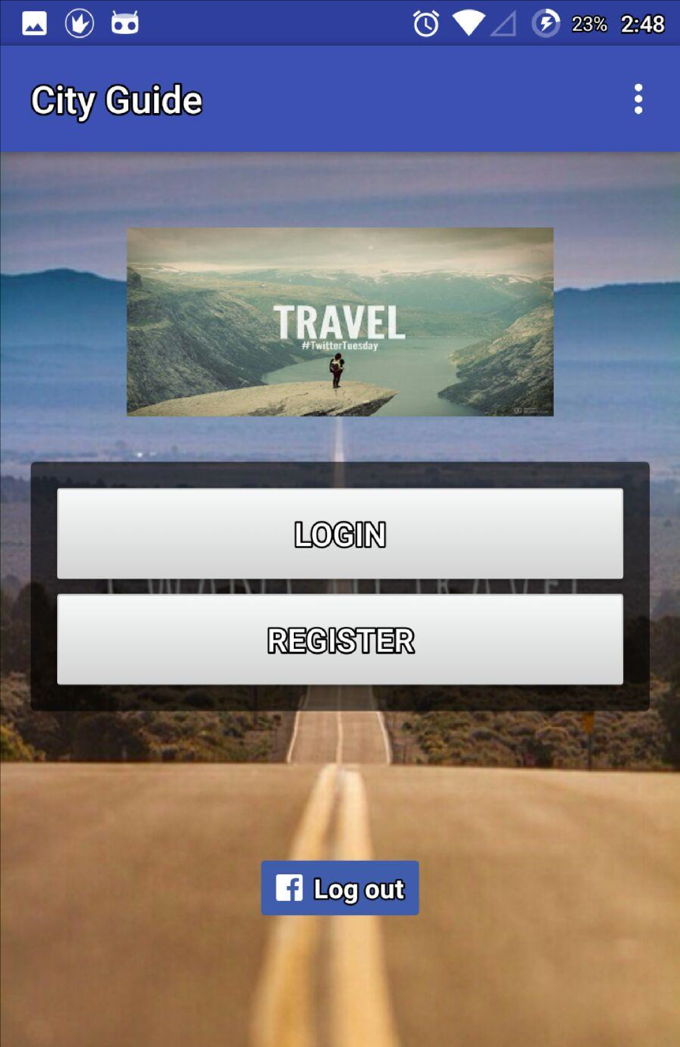
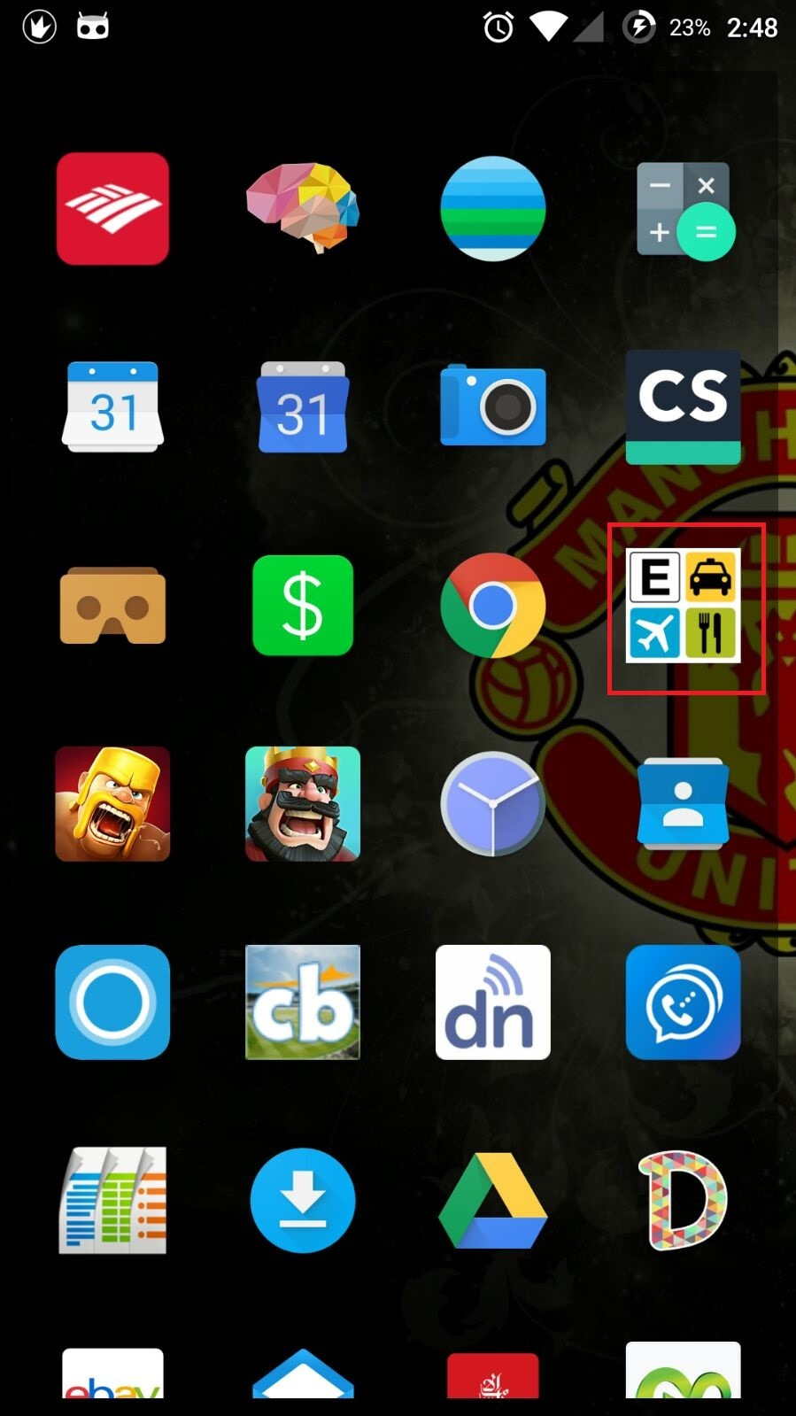
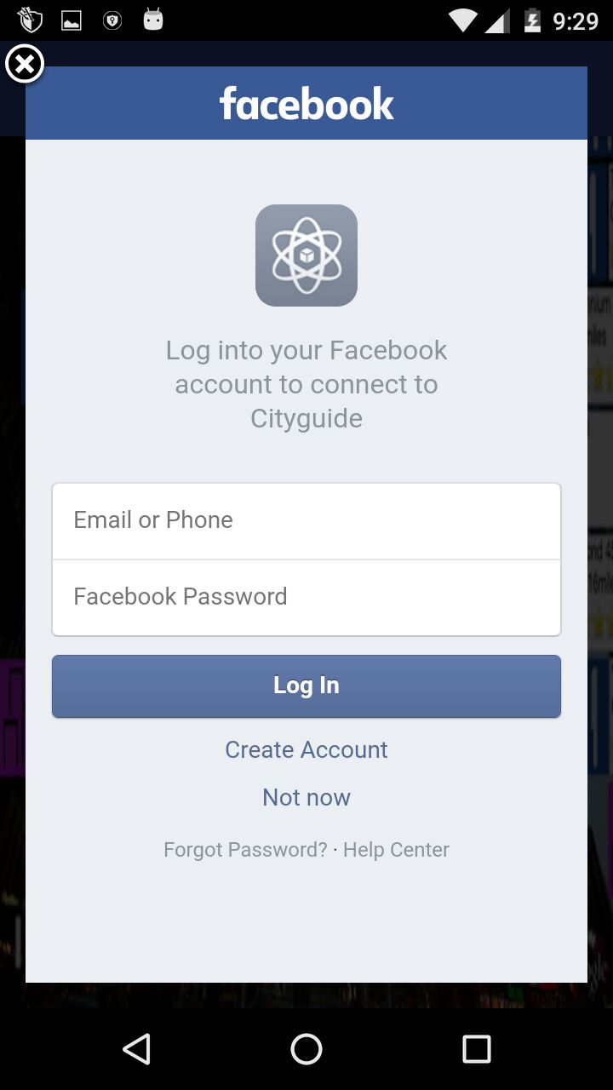
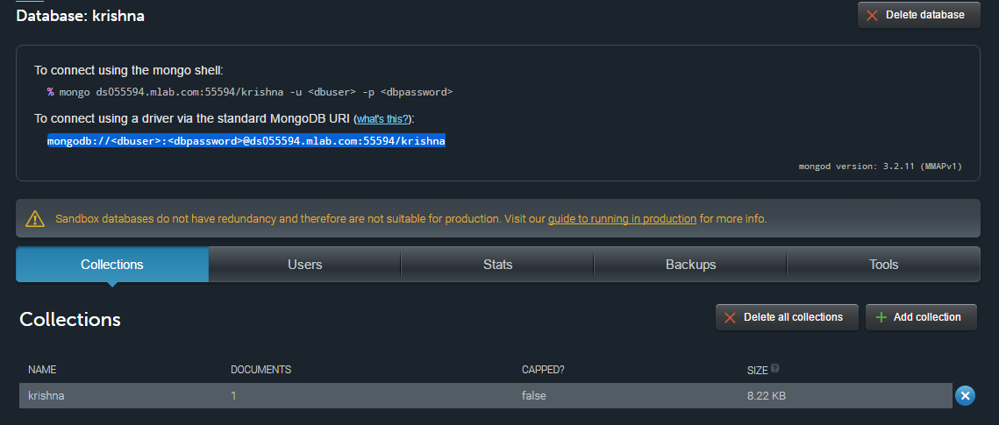
SCREENSHOTS:
1.
2.
3.
2. Main page
3.Register page
1. APP In Phone
4.
5.
5.Details stored in database
4.Login with fb

Slide 5
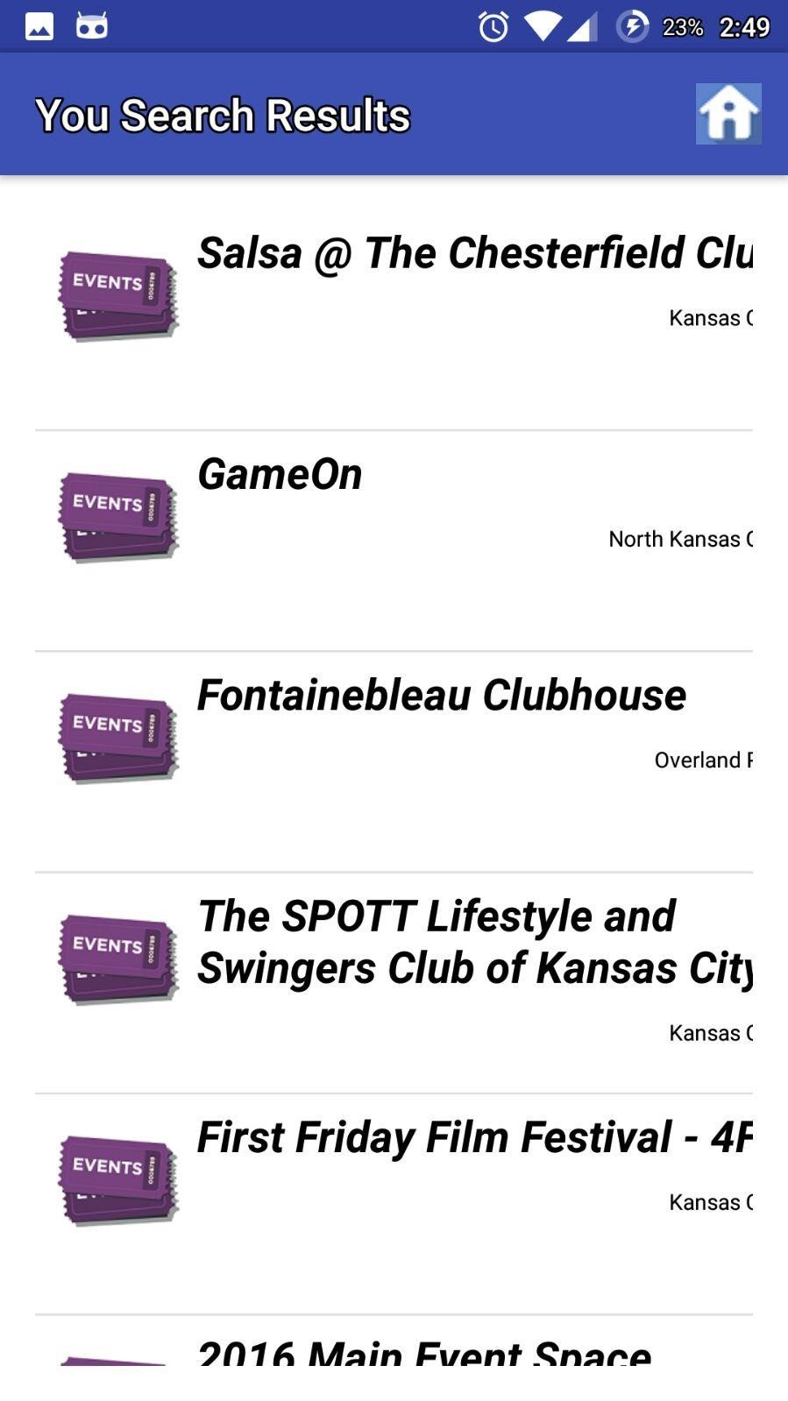
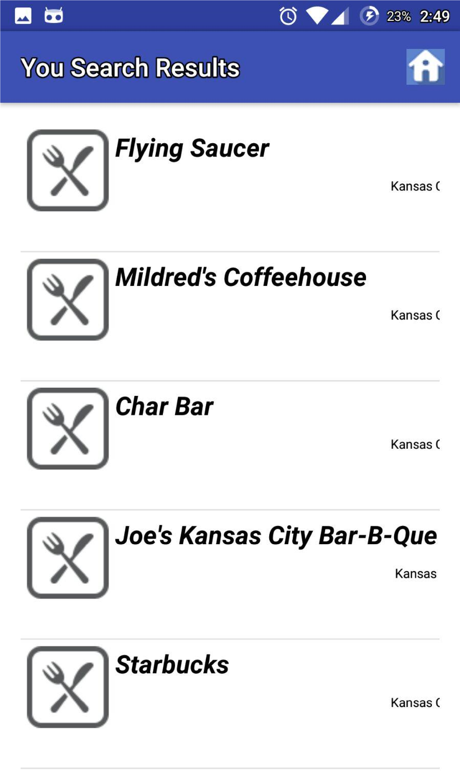
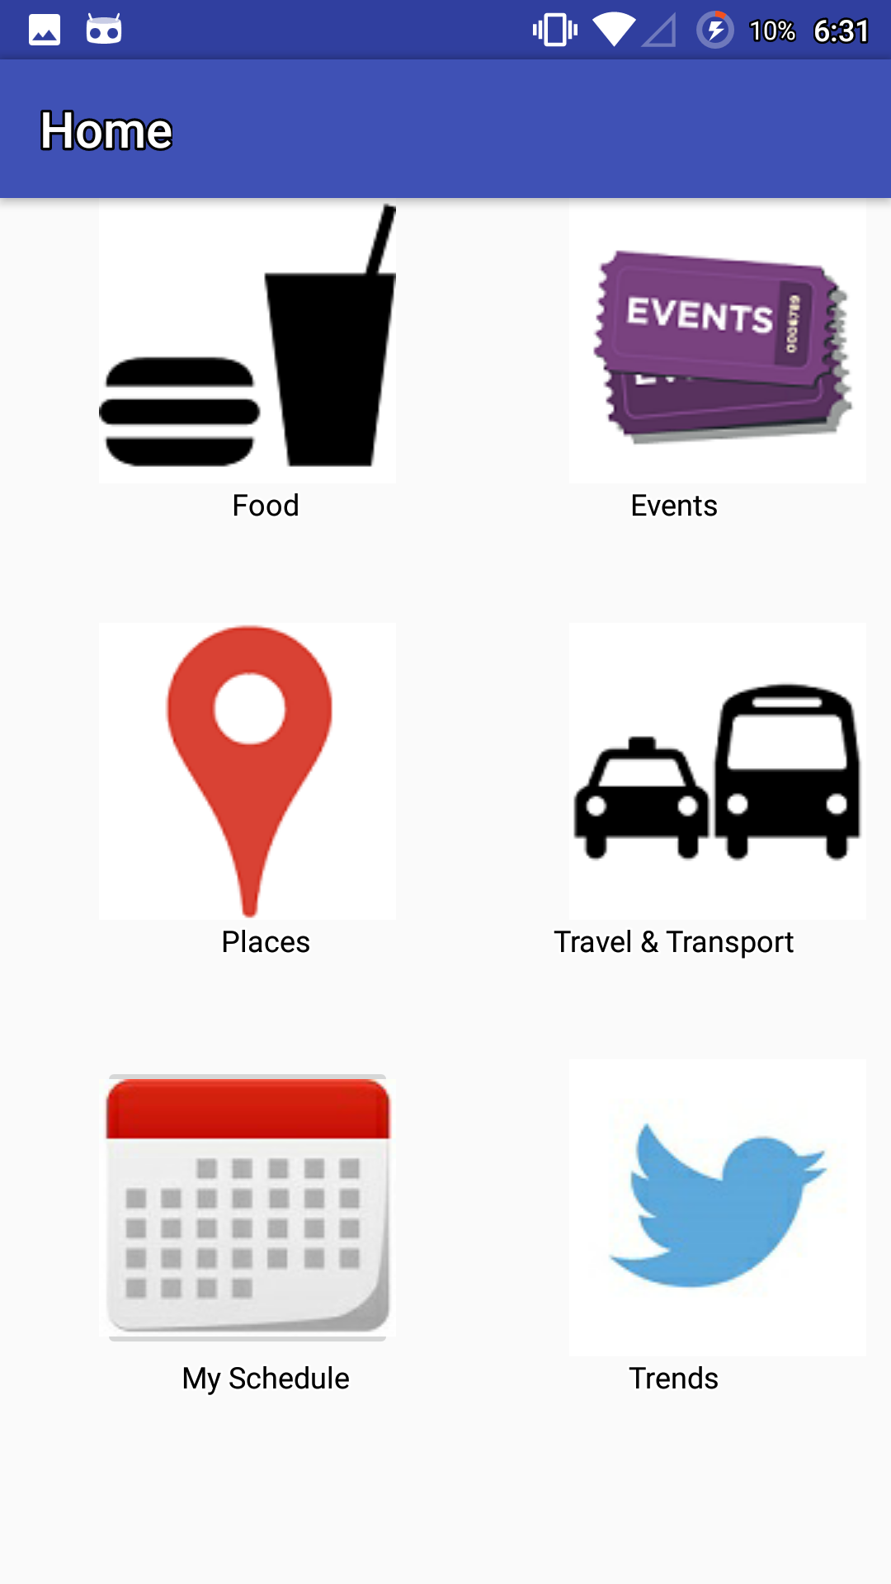
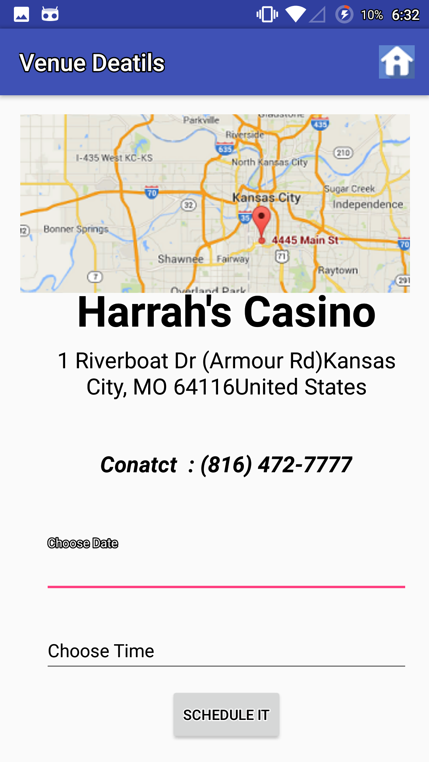
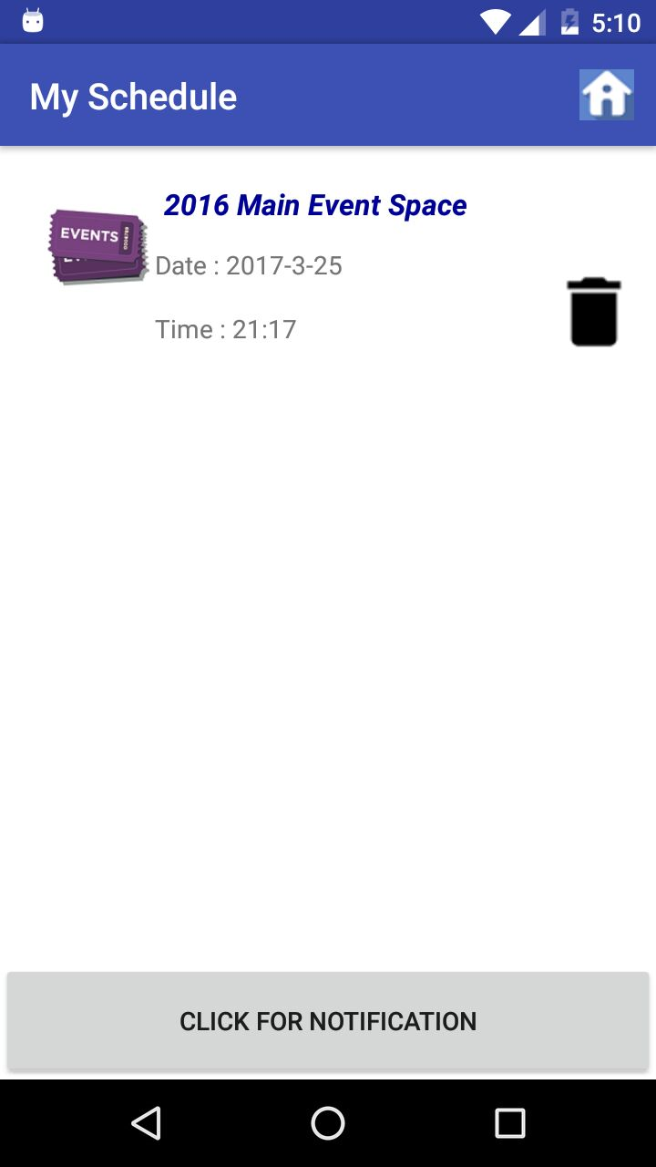
SCREENSHOTS:
1.
2.
3.
2.On Clicking events
3.On Clicking Foods
1.HOME PAGE
4.
5.
4.On Clicking “Harrah’s casino
”, details are displayed along with location.
5.Scheduling

